Slide 1



Stock Market Analysis
Presenter Name:
Yogita Khillari

Slide 2
Agenda
Introduction
Challenge Statement
Process(Data anlysis)
Data Insight
Summary

Slide 3

Introduction
Bank Nifty is a stock market index that tracks the performance of the most liquid and large capitalized Indian banking stocks. It offers investors a benchmark that captures the capital performances of the banking sector. The index includes stocks of 12 private and public sector banks in India.
Nifty Bank Index is comprised of the most liquid and large capitalized Indian Banking stocks. It provides investors and market intermediaries with a benchmark that captures the capital market performance of Indian Banks.
3

Slide 4
Challenge Statement :
Objective: To analyze market trends and their potential impact on a Bank industry
The goal is to identify trends and patterns in stock price movements, calculate moving averages and volatility for each company, and conduct correlation analysis to examine the relationships between different stock prices.
Scope and Objective:
TO Identify trends and patterns in stock price movements of Bank nifty. The Nifty weightage is calculated using a market capitalization-weighted methodology. This means that each stock's weight in the index is determined by its market capitalization. Market capitalization is calculated by multiplying the number of outstanding shares of a company by its current market price. The percentage gain is calculated using the formula: Percentage Gain = (Current Market Price Previous Closing Price) / Previous Closing Price × 100% and The P/E Ratio is calculated by dividing the market price of a share by the earnings per share

Slide 5
Data Analysis process
Data set :- The data has been collected in form of .csv file , Name as “stock market bank nifty “ . The data collected from yahoo finance website The stock price data for Bank nifty for past one year is used .
Continuous Data - Continuous data is a data type that deals with an infinite range of numerical data. They are generally defined within a specific range, with any value within that range. It can be easily divided into smaller fractional or decimal values
Data cleaning : The data directly load to power bi , then clean and categories by power query.
The dataset contains information about Bank nifty , including details about the ticker- Renamed as (bank code for data visualization ),Volume of share , Values (in crore) ,open , pre. Close , Low price , High price , 52 week high, 52 week low , .ad close .

Slide 6
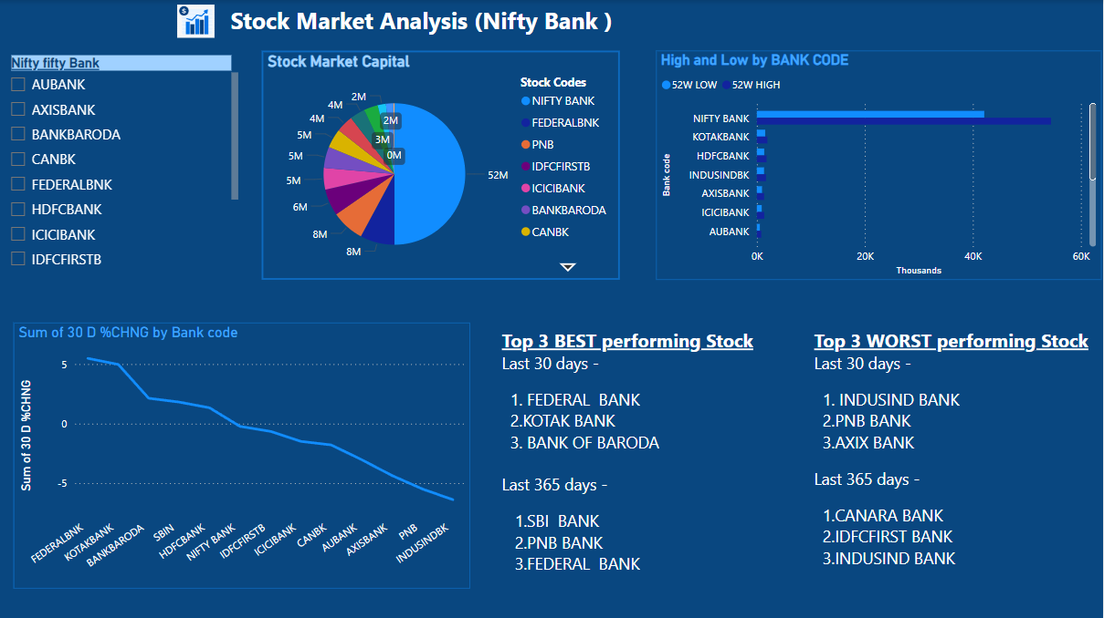
Stock market Analysis Dashboard

Slide 7
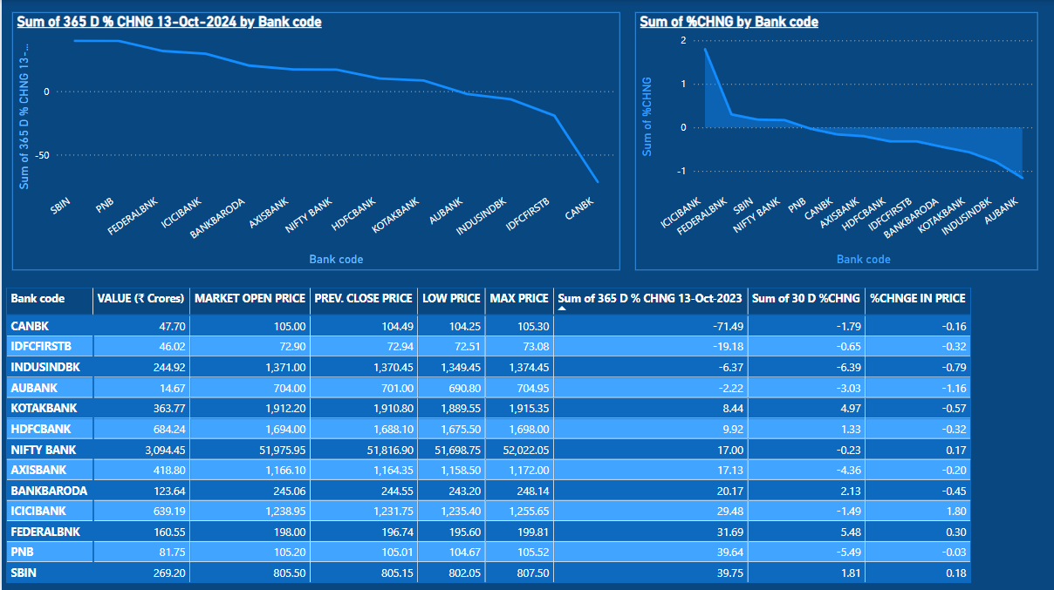
Stock market Analysis Dashboard

Slide 8
Data Analysis
STEPS FOLLOWED:
DATA IMPORT: Gathered data and imported it into Power BI for data transformation
DATA TRANSFORMATION: Used Power Query to clean the data. Checked for the data types.
REPORT CREATION: Created a user-friendly dashboard that helps the organization make important decisions. Tried some formatting features like conditional formatting, action page navigation and use of data bars.
Few of the formulae used as follows:
The percentage change in the stock's value. If the stock price increased, the formula is
(New Price - Old Price)/Old Price. If the stock price decreased, the formula is
(Old Price - New Price)/Old Price
The percentage gain is calculated using the formula: Percentage Gain = (Current Market Price Previous Closing Price) / Previous Closing Price × 100%
8

Slide 9
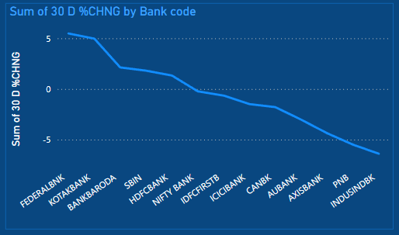
Top 3 BEST performing Stock
Last 30 days -
1. FEDERAL BANK
2.KOTAK BANK
3. BANK OF BARODA
Top 3 WORST performing Stock
Last 30 days -
1. INDUSIND BANK
2.PNB BANK
3.AXIX BANK
9

Slide 10
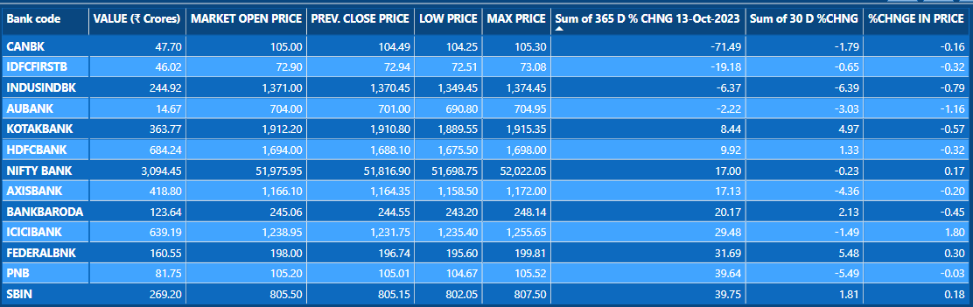
Data Analysis
Top 3 BEST performing Stock
Last 365 days -
1.SBI BANK
2.PNB BANK
3.FEDERAL BANK
Top 3 WORST performing Stock
Last 365 days -
1.CANARA BANK
2.IDFCFIRST BANK
3.INDUSIND BANK
10

Slide 11
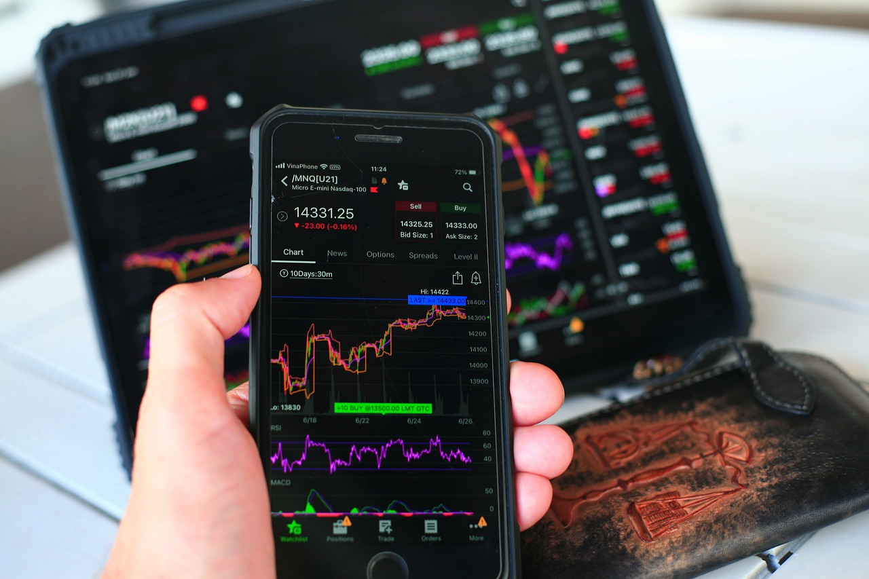
Summary
Stock analysis is a method for investors and traders to make buying and selling decisions. By studying and evaluating past and current data, investors and traders attempt to gain an edge in the markets by making informed decisions..
Technical analysis focuses on the study of past and present price action to predict the probability of future price movements. Technical analysts analyze the financial market as a whole and are primarily concerned with price and volume, as well as the demand and supply factors that move the market.
The values for share market change daily . The Analysis is done by past and current data .
11

Slide 12


Thank you
Yogita Khillari
yogitakhillari14@gmail.com

